Slide 1
Daily Lesson Plan:
[INSERT LESSON TITLE/#]
[INSERT DATE]
[INSERT TEACHER NAME]
Notes:
Say (video or in person):
[Introduce yourself and provide today’s focus]

Slide 2
Today’s Agenda
Objectives: I can …
  [INSERT Objective 1]
  [INSERT Objective 2]
I’ll know I’ve succeeded at understanding the objectives when …
  [INSERT success criteria]
Unit Essential Question(s):
  [INSERT question]
Notes:
Getting Started/Using a “Do Now” activity:
Before a synchronous class officially begins: set a timer so students know when the lesson will begin. Set the expectation that students will have completed the “do now” by then.
This activity could be a polling question, require student to complete a “quick write” or do a problem, contribute to a discussion board, or something else.
Check out the templates at the end of the slide deck for “do now” ideas.

Slide 3
What’s Happening This Week?
WEEK 1 | MONDAY | TUESDAY | WEDNESDAY | THURSDAY | FRIDAY
 | Unit introduction Unit 1 Lesson 1: Overview/key questions Activity | Think-aloud of “After 20 Years” Unit 1 Lesson 2: Workshop: Author’s Craft | Narrative techniques Unit 1 Lesson 3: Video Guided practice | Weekly Quiz Unit 1 Lesson 4: Workshop: Vocabulary in Context | No School
Work to complete | Read “After 20 Years” | Author’s Craft writing assignment | Prepare for quiz | Quiz | No school
Notes:
Housekeeping: Weekly Overview
Give students a quick overview of what to expect each day at the start of the week. Include announcements and assignments that will be due.

Slide 4
Unit Essential Question:
[INSERT]
Notes:
Say (video or in person):
Let’s read our Essential Question(s) for the week. Can you predict what our objective will be today for our lesson?
Students can respond orally, in a chat feature, or you can pause in a videoed lesson to have them write down their answers.

Slide 5
Review
[INSERT activity]
  Activity should connect previous learning with connections to today’s learning
Notes:
Review:
Open the lesson with a type of guided review activity. This could be a game or other highly engaging activity. Keep it short.
Make sure to think about what students will be doing during your review.
It is a good idea to choose an activity that calls for some kind of student input to see who is participating early in a lesson.
You may do a pre-assessment here if you are at the beginning of a unit.
Check out the templates at the end of the slide deck for review activity ideas.

Slide 6
Lesson Introduction
[INSERT activity]
Add citation if needed. Delete text box and orange line if not.
Notes:
Lesson Introduction/Anticipatory Set:
The anticipatory set is intended to garner student interest and facilitate student discussion.
It may touch on a major concept, theme, or essential question from the unit. It may include ideas, references, or analogies that are culturally relevant to students.
Surveys, graphic organizers, short video clips, or other highly engaging activities are recommended.
Ensure students that there are no right or wrong answers at this step in their learning.
Check out the templates at the end of the slide deck for anticipatory set ideas.

Slide 7
Learn: Model (I Do!)
Our goal for today:
[INSERT objective 1]
[INSERT success criteria]
[INSERT model]
Notes:
Modeling:
This stage of the lesson should focus on the modeling portion of instruction (using a gradual release model).
Show and explain the skill or concept students are learning for the day.
Put the objective that is involved with the skill or concept on the board and remind students of it throughout the lesson.
Model using an exemplar for the task students will complete. Have students identify through mics or chat what makes the exemplar high quality work.
These identified elements are the beginning of your success criteria for the day’s lesson.

Slide 8
Learn: Let’s Practice Together!
[INSERT activity]
Notes:
Guided Practice:
This stage of the lesson focuses on the guided practice section of the gradual release instructional model.
If synchronous, have students assist you with the skill they are learning in chat, on mic, or on the board to check their understanding during this stage.
You can help students solidify the success criteria for the lesson while analyzing the exemplar.
You could also include partner work in the whole group using a virtual think-pair-share style activity.
Ask students to send a private message with their thoughts or answers to the person directly above and below them on the participant list in your session.
You may include a timer so that students know when you expect their input.

Slide 9
Learn: Your Turn!
[INSERT activity]
Notes:
Independent Practice:
This stage of the lesson focuses on the independent practice section of the guided release instructional model.
Continue to have students work on more difficult examples or problems at this stage before you assign group work or a graded task.
Give students a way to check their answers, perhaps on another slide when they finish.
Gather formative data about common misconceptions and students who may need more support as they work.

Slide 10
Apply it!
Our goal for today:
[INSERT objective 1]
[INSERT success criteria]
[INSERT today’s task]
Notes:
Applied Practice:
This stage of the lesson focuses on the applied practice section of the guided release instructional model.
This is the point where students may be released to complete a graded activity or a group work task in breakout rooms.
Some lessons may not get to this stage of application depending on lesson pacing and teacher intent.

Slide 11
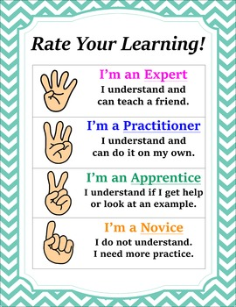
Closure and Reflection
Our goal for today:
[INSERT objective 1]
[INSERT success criteria
Notes:
Closure:
Have students anonymously rate their understanding of the day’s objective and/or progress toward the success criteria. They would mark their response on the whiteboard or in a polling activity.
You could also use this closure for more open-ended discussion or reflection questions, or you may have students fill out a survey on their level of involvement in the day’s group work activity if the lesson included a breakout activity.

Slide 12
Exit Ticket
[INSERT link to exit ticket or activity]
Notes:
Exit Ticket:
Include some kind of short activity, quiz, or form to assess student understanding at the end of the lesson. You can use this data throughout the week to gauge student progress toward mastery.
The exit ticket should generally have no more than three to five questions so that students can complete it quickly at the end of the session.
You may dismiss a student once you have his or her exit ticket if you so choose.

Slide 13
Looking Ahead
DUE THIS WEEK
Tomorrow:
  [INSERT activities]
[INSERT assignment 1 (details)]
[INSERT assignment 2 (details)]
Notes:
Closing Slide:
This slide signals to students that the lesson for today is finished and reminds them of what will happen in class the next day and which assignments are due.

Slide 14
Activity templates
The next several slides are resources to utilize when developing activity templates for engaging students.

Slide 15
Do Now: On the whiteboard, fill out one, two, or all of the columns below
SOMETHING I KNOW about the Holocaust / WWII | SOMETHING I WANT TO KNOW about the Holocaust / WWII | SOMETHING I LEARNED about the Holocaust / WWII Today
[INSERT] | [INSERT] | [INSERT]
Notes:
This KWL chart could double as an anticipatory set and do now at the start of a lesson. you may choose to cover the orange column at the start of the lesson with whiteboard assets and reveal it at the closure for a reflection activity.

Slide 16
Review: Padlet activity
Answer in today’s Padlet with your name and your answer:
  [INSERT open-ended question]
Notes:
Padlet is an outside resource that allows students to post text and pictures to a moderated wall for other students to reply to and like or rate. use this resource in class and screen share the wall of the Padlet to the main room as students work at the start of class. This format works well for writing activities, student generated questions, and open ended questions.

Slide 17

Practice or review: Millionaire!
Keep track of your score and see if you can become a “millionaire” by the end of the game!
Rules:
  Respond via the poll for each question with the answer you think is right before the timer goes off.
  See how many you can get correct in a row! If you miss a question, make a note of how much money you walked away with and keep playing!
Notes:
The following two slides are an example of a review game students could play at the beginning of a lesson or during a review session. Whenever playing a game or introducing a new activity, make sure to include a slide with general and simple rules so that students know your expectations during the game.

Slide 18
Millionaire: INSERT Question 1
Who Wants to be Millionaire!
[INSERT question]
  Option A
  Option B
  Option C
  Option D
Question 10 • $1,000,000
Question 9 • $500,000
Question 8 • $250,000
Question 7 • $125,000
Question 6 • $64,000
Question 5 • $32,000
Question 4 • $16,000
Question 3 • $2,000
Question 2 • $1,000
Question 1 • $100

Slide 19
Review: Kahoot!
We will review [INSERT content] today using Kahoot! ☺
  GAME LINK:
  GAME CODE:
  Put a thumbs up in chat when you are logged on!
Notes:
To use Kahoot in a virtual setting, have students login First and then screen share your browser where the question is displayed so that students can see it. Kahoot can also be assigned asynchronously as practice.

Slide 20
Lesson Introduction: 4 Corners
Insert a controversial statement related to your objective here.
Strongly agree | Agree
Strongly disagree | Disagree
Notes:
This classic lesson introduction/anticipatory set has been modified to work in a virtual setting. Once you have read the controversial statement, students will put their pointers or a checkmark on the square that matches their level of agreement with the statement. You can use these responses to talk about class trends or even break students into groups for an activity.

Slide 21
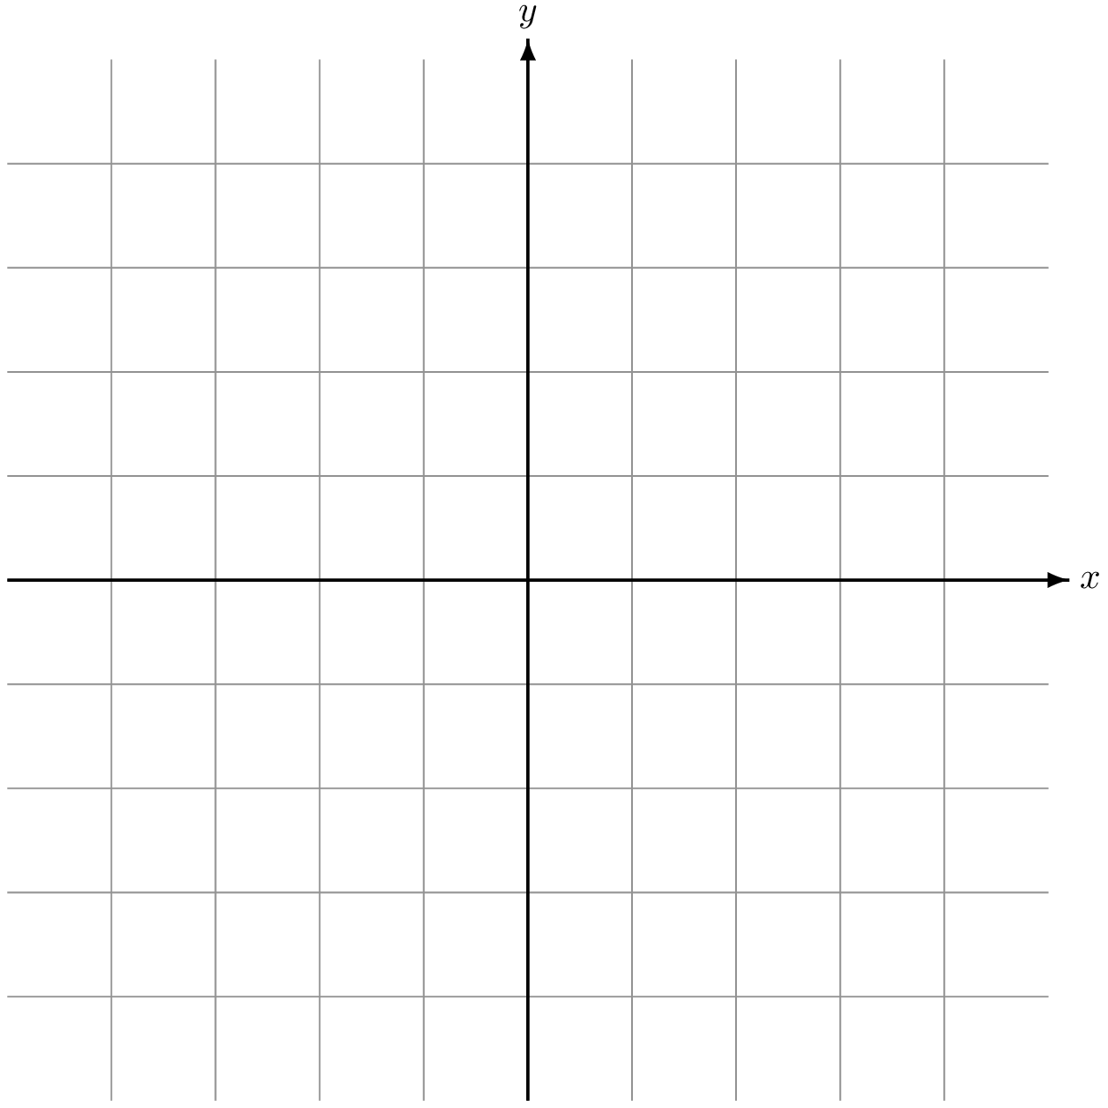
Lesson Introduction: Agreement Grid
Long-term loyalty
STATEMENT 1: In a friendship, loyalty through the years is most important.
STATEMENT 2: Friendship should be focused on enjoyment in the present.
STATEMENT 3: Friends can disagree on core beliefs and still be close.
STATEMENT 4: Among friends, shared values are most important.
Shared beliefs & values
Diverse worldviews
Present enjoyment
Notes:
This anticipatory set could be used to explore student beliefs and themes that may appear in a unit. Students use pointers or draw a dot on the chart to match their level of belief in the statements. This activity could be used as a cross curricular activity with math for students who are learning how to plot on an XY chart.

Slide 22
Learn: Pre-Reading Activity
INSERT polling question
Title:
Passage:
Answer 1
Answer 2
Answer 3
Answer 4
I’m still thinking
Notes:
This slide could be used to preface a reading passage and give more information on historical context, vocabulary, or the author. Include a quick comprehension check polling question to make sure students are listening.

Slide 23
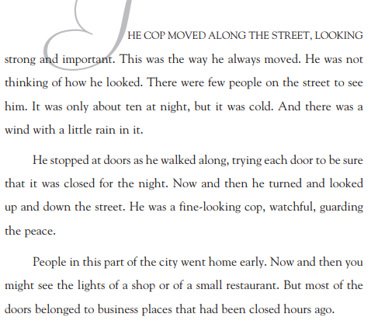
Let’s Read: INSERT Story Title
During reading, I should be …
Question 1
Question 2
Question 3
I’m still thinking
Notes:
This template may give an idea of how to structure read-aloud activities with students in class. Put the text on one side of the slide, and include quick checks, a text annotation guide, questions, notes, and/or expectations on the left. During reading, reference those checks or notes at the beginnings and ends of slides. Keep it interactive by asking students to annotate key details and evidence they see in the text.

Slide 24
Breakout Room Activity: Rules Slide
When you get to your breakout room, do this first.
When you are finished, do this.
Team roles:
  First person:
  Second person:
  Third person:
  Fourth person:
Please put your initials next to your responses so that I know you are working! Raise your hand if you have a question.
Notes:
Before a breakout activity, use this slide to provide students with the rules and expectations you have for the activity to ensure their success. You may also show students a preview of what slides will be in the breakout rooms or an example of successful group work before the activity.

Slide 25
Group Work Activity
Same | Different
1. Setting: Ways that the story and film are the same include … | 1. Setting: Ways that the story and film are different include …
2. Characters: | 2. Characters:
3. Plot events: | 3. Plot events:
4. Resolution: | 4. Resolution:
**Please put your initials next to your work!**
MEDIA 1 LINK:
MEDIA 2 LINK:
Notes:
To ensure accountability during group work, you should make sure every student is required to complete something on the board or in an assignment that shows evidence of their participation. you may save the student work slides to review after class is over.
In this group work example, each student in the 4-person breakout room has been given a number and corresponding set of boxes to fill in as they watch a short media adaptation of a story and then compare it to the short story they read aloud the day before. At the end of the activity, you may publish the student work slides to the main room and have the whole group debrief and/or discuss what they did.

Slide 26
Closure: Reflection Questions
Waterfall question (type until the timer goes off and THEN hit enter!):
  What do you think the author of this story was trying to tell readers about friendship?
[INSERT model answers (e.g., grabbed from chat)]:
Notes:
You can use the waterfall response style to get more responses from students. Preface the activity by telling students that you will read a question aloud and then put a timer on the board and close public chat permissions until the timer goes off. Students are to type their responses into the chat box but not hit enter until that timer goes off in order to “flood” the chat with responses.
After students respond, you may highlight certain responses as strong examples by putting them up on the whiteboard. Make sure to encourage and praise every student who responded.

Slide 27
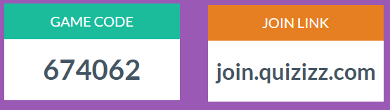
Exit Ticket: Quizizz Activity
Finish before you leave today!
Enter in your name as (First initial. Lastname)
  Example: M. Smith
Notes:
join.quizizz.com
Quizizz is a resource that can be used for review, assessment, or even pre-assessment. After you join and create an account, you can either create or use previously created quizzes with your students. This game is fun and easy to set up and does not require screen sharing, as each student works independently on the activity. At the end of the quiz, you can download an Excel spreadsheet with each students’ responses, so remind students to login to Quizizz with their first names and last initials.

